Slide 1
Web of Science
User Manual
Class 25, Group 1
Group members: 林轩正, 李文卓, 左润泉, 徐朔, 韩梓豪, 闫大卫
Nov. 6, 2025
Notes:
Hello everyone. Today I’ll walk you through a concise user manual for Web of Science, also called WoS, that’s designed to make literature searching, managing, and basic analysis straightforward and teachable. I’ll follow a simple workflow: first an introduction to WoS and the manual, then practical steps for searching and managing results, and finally the tools and value-added features you can use in your research.

Slide 2
01 Introduction
02 Functional Workflow
03 Extension & Value
04 Work Allocation

Slide 3
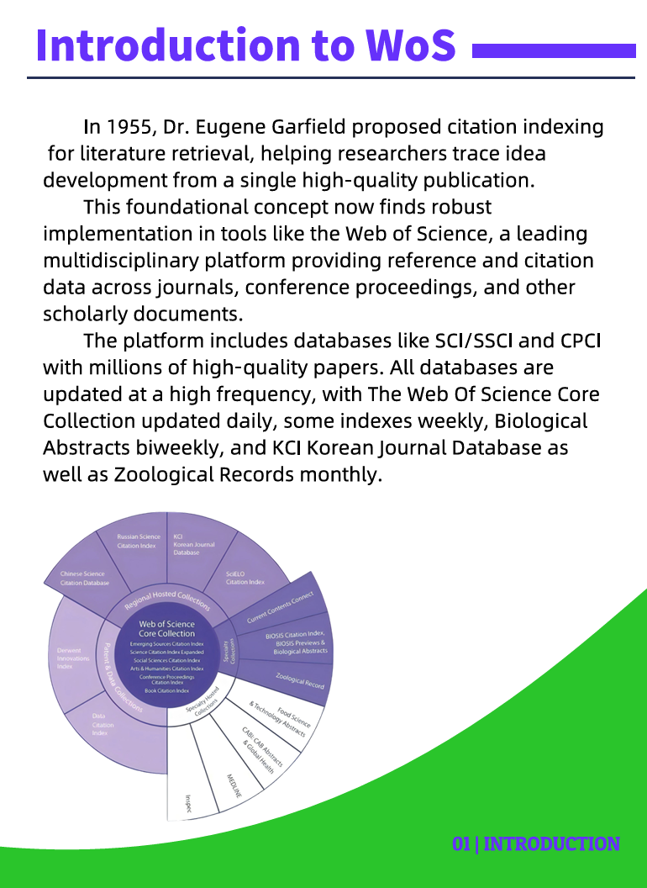
About WoS
Web of Science (WoS) is a multidisciplinary academic database.
It provides access to high-quality journals, conference papers, and citation data.
Researchers use WoS to trace ideas, find influential works, and measure impact.
Notes:
Web of Science, or WoS, is a multidisciplinary academic database that gives us access to high-quality journals, conference papers, and citation data. It’s a place to trace how ideas develop, find influential works, and measure academic impact. Over the next slides I’ll show how our user manual helps you use those features more effectively. Now that we know what WoS is and why it matters, let’s look at the manual that helps you use it.

Slide 4
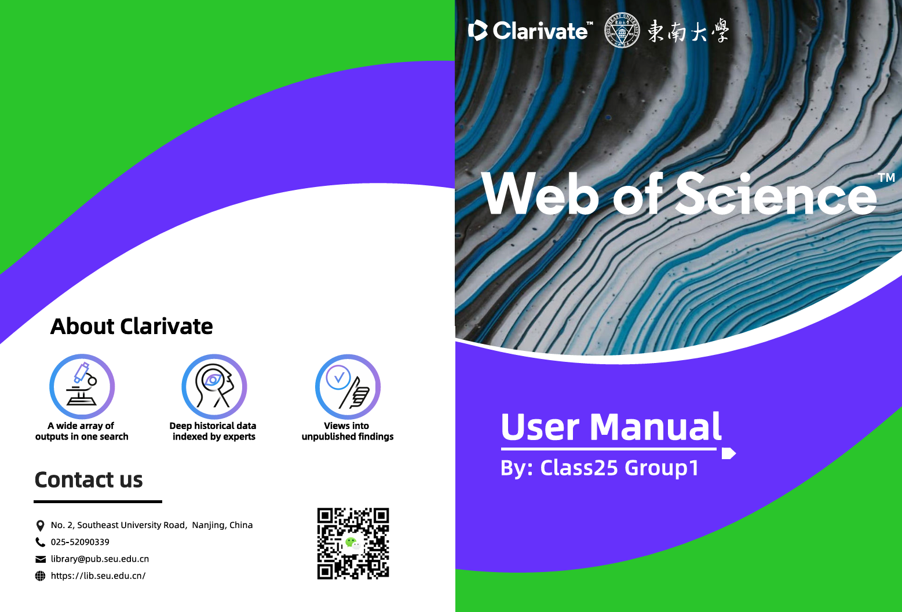
About the User Manual
Concise step-by-step handbook
Combines text, screenshots, and examples
Serves as both a reference and a learning guide
Notes:
General, this manual is a concise, step-by-step handbook combining short text, screenshots, and concrete examples. It’s designed to be both a quick reference and a practical learning guide you can follow while doing searches. Think of it as a hands-on companion rather than a comprehensive textbook.

Slide 5
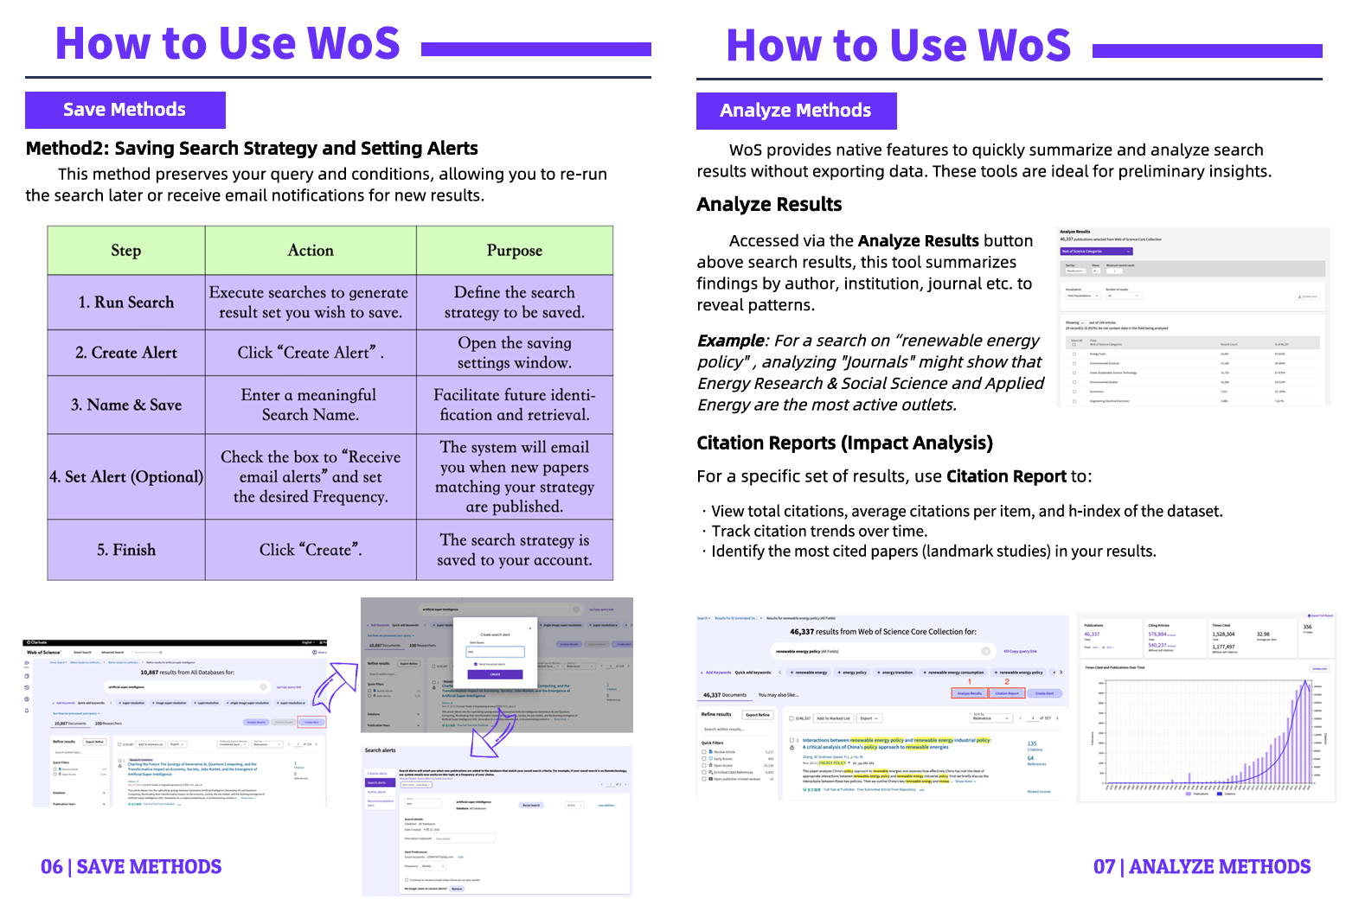
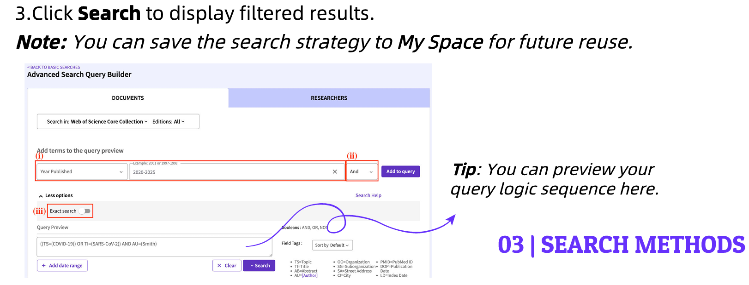
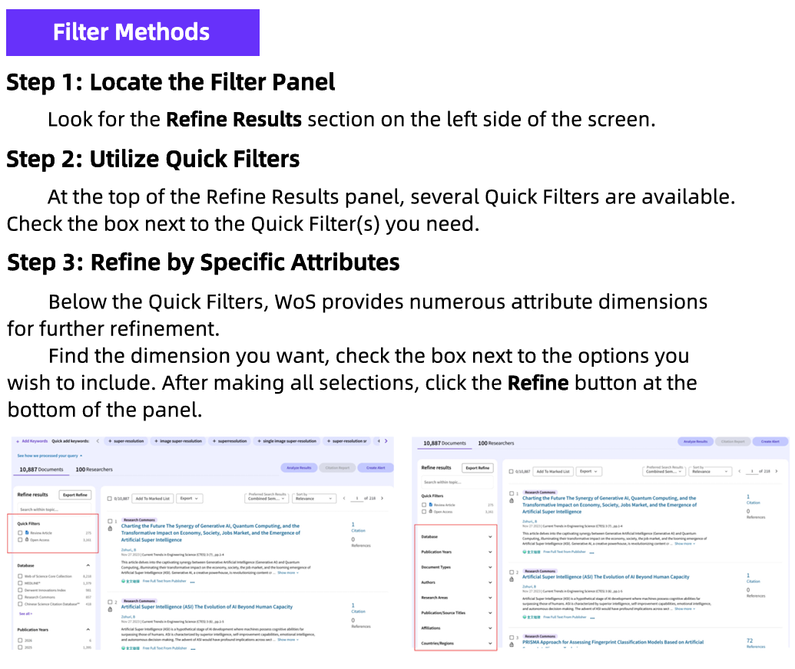
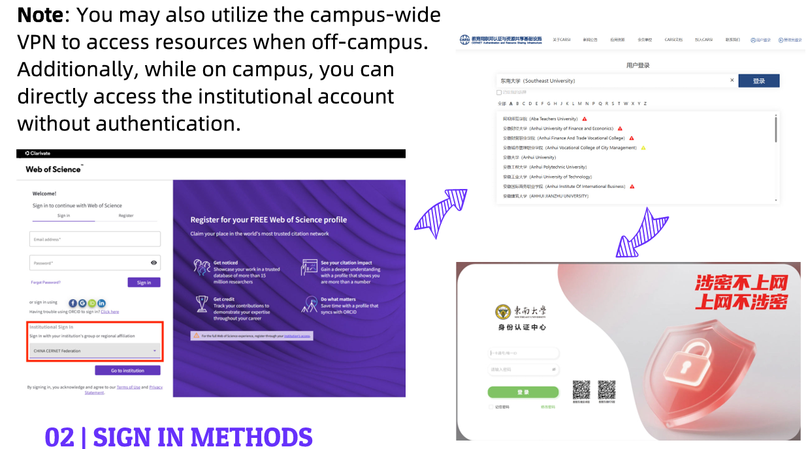
Design Principles
Clarity: short instructions, language plain
Usability: action-oriented steps, screenshots
Accessibility: examples and visual cues
Consistency: unified layout and formatting
Notes:
The manual follows four guiding principles: clarity, which means short instructions written in plain language; consistency, which ensures a unified layout and formatting; usability, which emphasizes action-oriented steps supported by screenshots; and accessibility, which provides examples and visual cues so everyone can follow along. These principles keep the manual easy to use in class and in practice.

Slide 6

Target Users
This user manual aims to help teachers and students use the database more effectively and promote learning and research.
Students & early-career researchers
Instructors & librarians
Anyone conducting literature reviews
Notes:
Who are the intended users of this manual? Basically, this manual is mainly for SEUers, like teachers and students who might feel uncertain or have trouble using the Web of Science at the beginning. Still, it can also help early-career researchers, instructors, and librarians. In short, anyone doing literature reviews will find it useful. The examples are simple enough for newcomers but still meaningful for advanced users.

Slide 7
01 Introduction
02 Functional Workflow
03 Extension & Value
04 Work Allocation

Slide 8
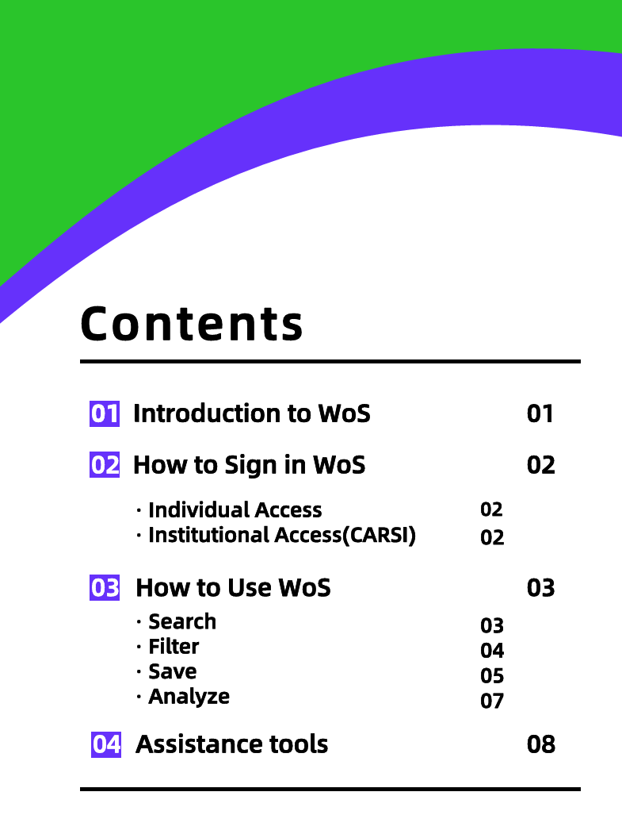
Manual Structure
The manual follows a logical, user-centered structure: Access → Search → Manage → Analyze → Assist
Each section builds on the previous one and covers every essential operation users need to know.
Notes:
This slide shows the structure of our manual. The manual follows a user-centered flow: Access → Search → Manage → Analyze → Assist. Each section builds on the previous one so you progress naturally from logging in to analyzing results and using assistance tools. This mirrors a typical research workflow. Now let’s jump right in.

Slide 9
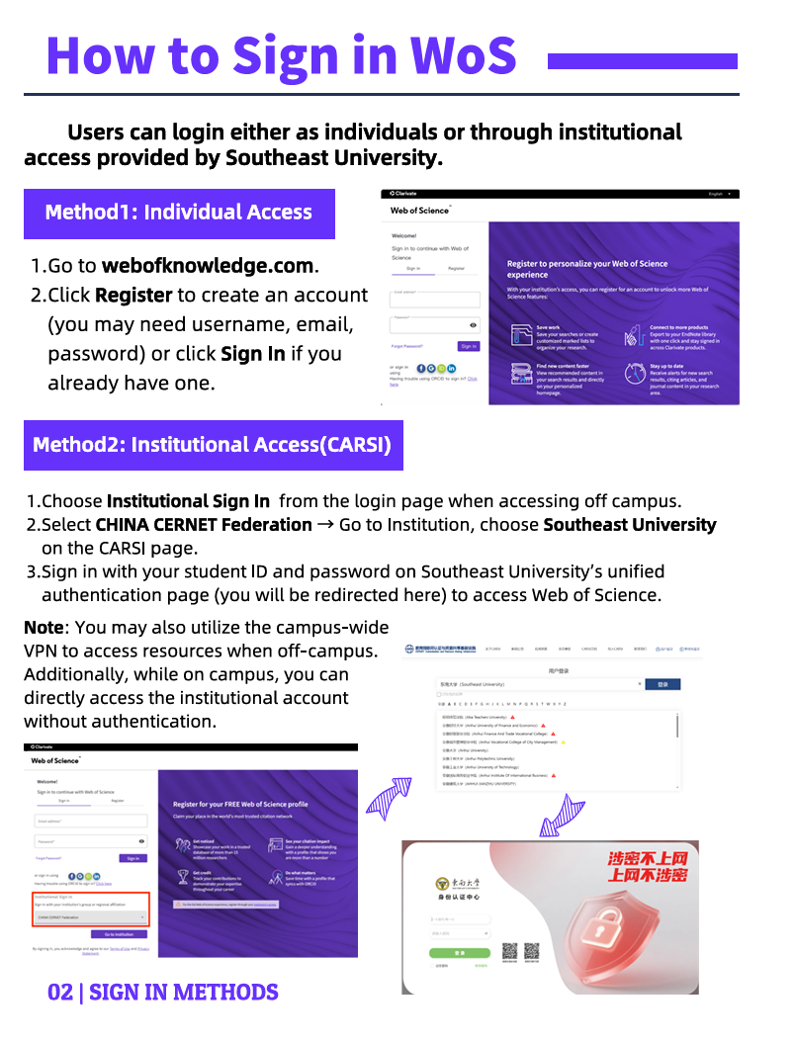
How to Sign In to WoS
Users can log in either as individuals or through institutional access provided by Southeast University. We start by visiting webofscience.com.
Notes:
To start, visit webofscience.com and choose a sign-in method: individual account or institutional access. The manual provides screenshots for both routes so you can follow each click without confusion. We’ll demonstrate both briefly.

Slide 10
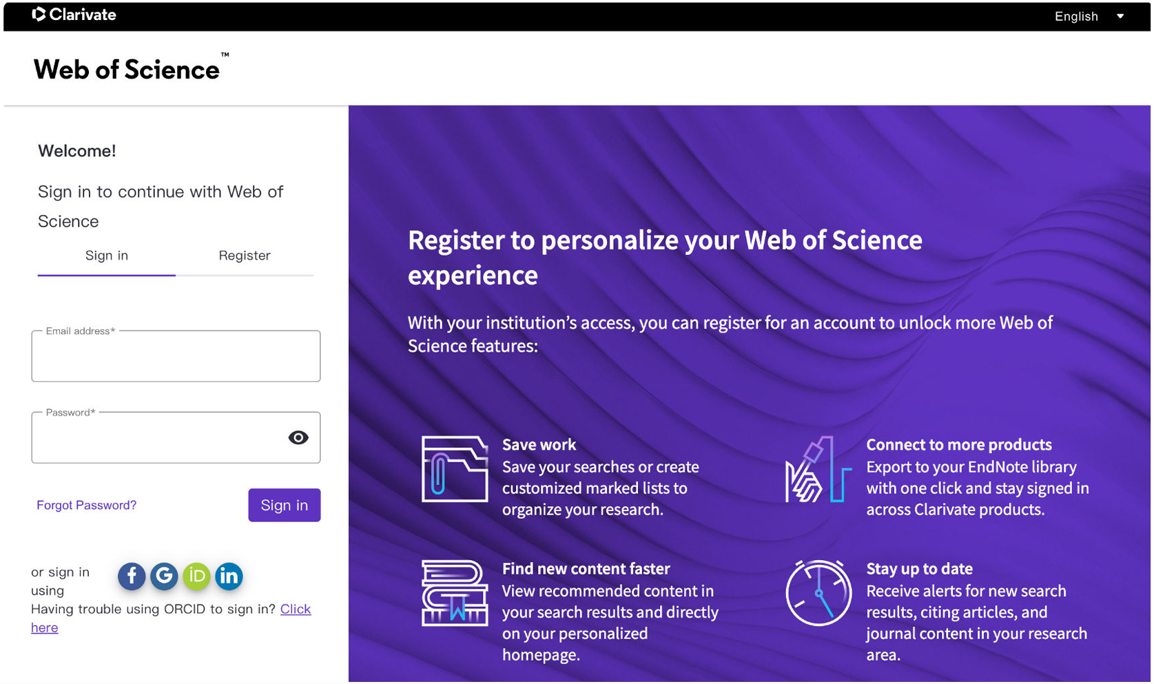
Individual Access
Click Register to create an account (email, password, name, verification), or click Sign In if you already have one.
Notes:
For personal accounts, click Register, enter your email, password and name, and complete verification; if you already have an account, click Sign In. The manual highlights the required fields so first-time setup is quick and error-free.

Slide 11
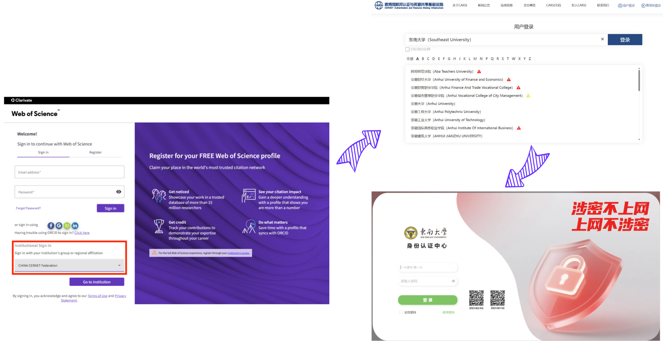
Institutional Access(CARSI)
Select CHINA CERNET Federation, then choose Southeast University on the CARSI page.
Choose Institutional Sign In on the login page.
Sign in with your student ID. That’s it!
Notes:
But for us SEU students, institutional access is the better option, since our university has already purchased the subscription, and all access is 100% free. For institutional access choose Institutional Sign In, select CHINA CERNET Federation, and pick Southeast University on the following page. Then sign in with your student ID and password. The manual shows every step with screenshots for clarity.

Slide 12
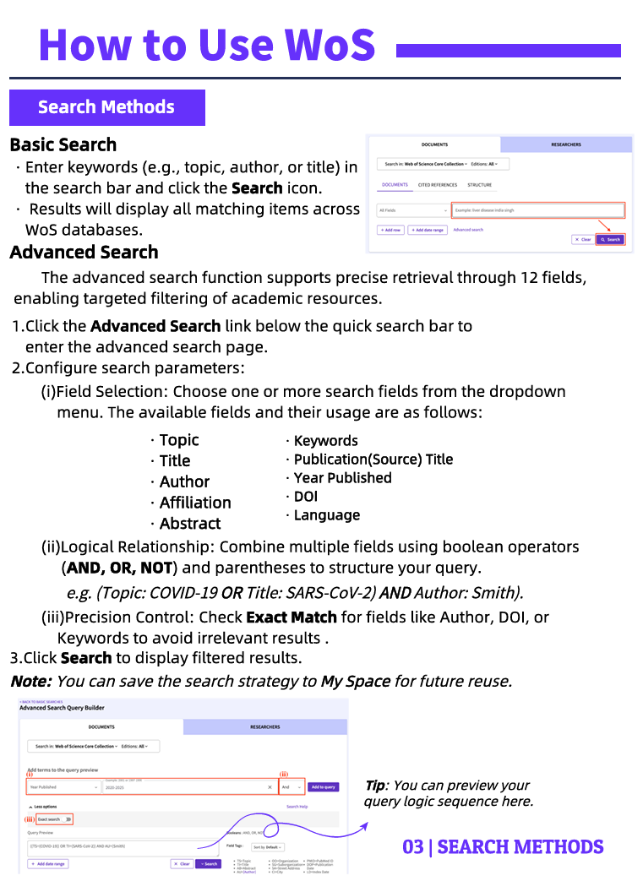
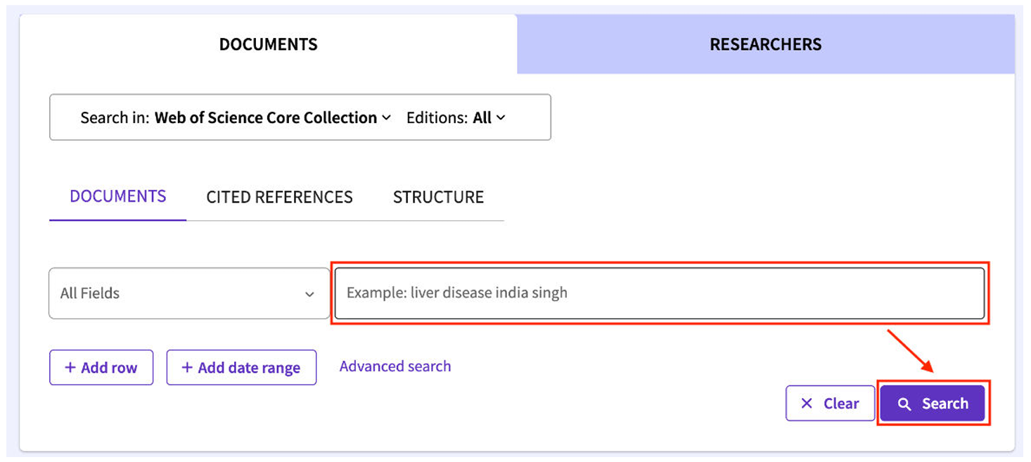
Basic Search
Enter keywords (e.g., topic, author, or title) in the search bar and click search. The results will display all matching items across WOS databases.
Notes:
Now, we’ve come to the core part — searching. The simplest way is the basic search, also called smart search. On the WoS homepage there’s a search bar where you type keywords like topic, author, or title into the search bar and hit Search. The results page shows matching records across WoS databases. Remember basic search is excellent for exploratory or one-off queries.

Slide 13
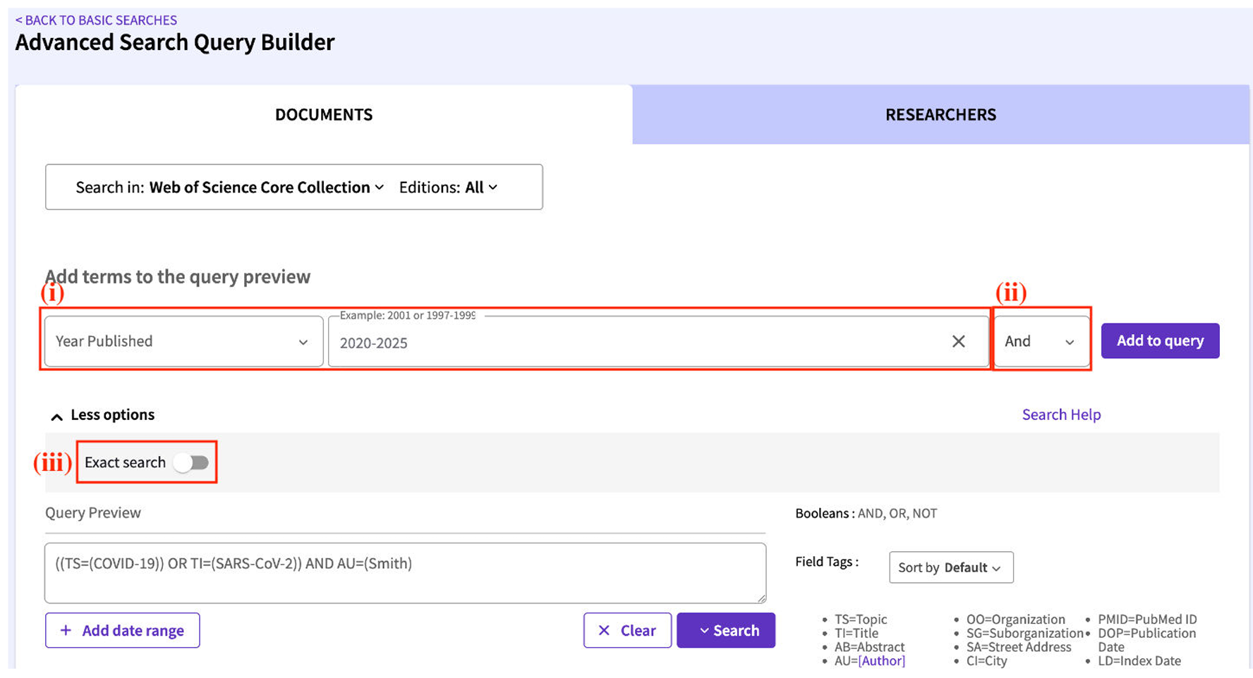
Advanced Search: Principles
Click Advanced Search below the quick search bar to open the advanced search page. Configure the search parameters to perform an Advanced Search.
Field selection
Boolean logic
Precision options
Notes:
If you need precise control, use Advanced Search. Advanced Search is designed for users who need more control over their queries. Unlike the basic search bar, it allows you to specify fields — such as title, author, organization, or publication year — and combine them using AND, OR, and NOT. This function is especially useful when you want to narrow down large result sets or explore the relationship between specific keywords. For example, you can limit your search to papers written by a particular author on a certain topic or published within a defined time period to fit your own research question.

Slide 14
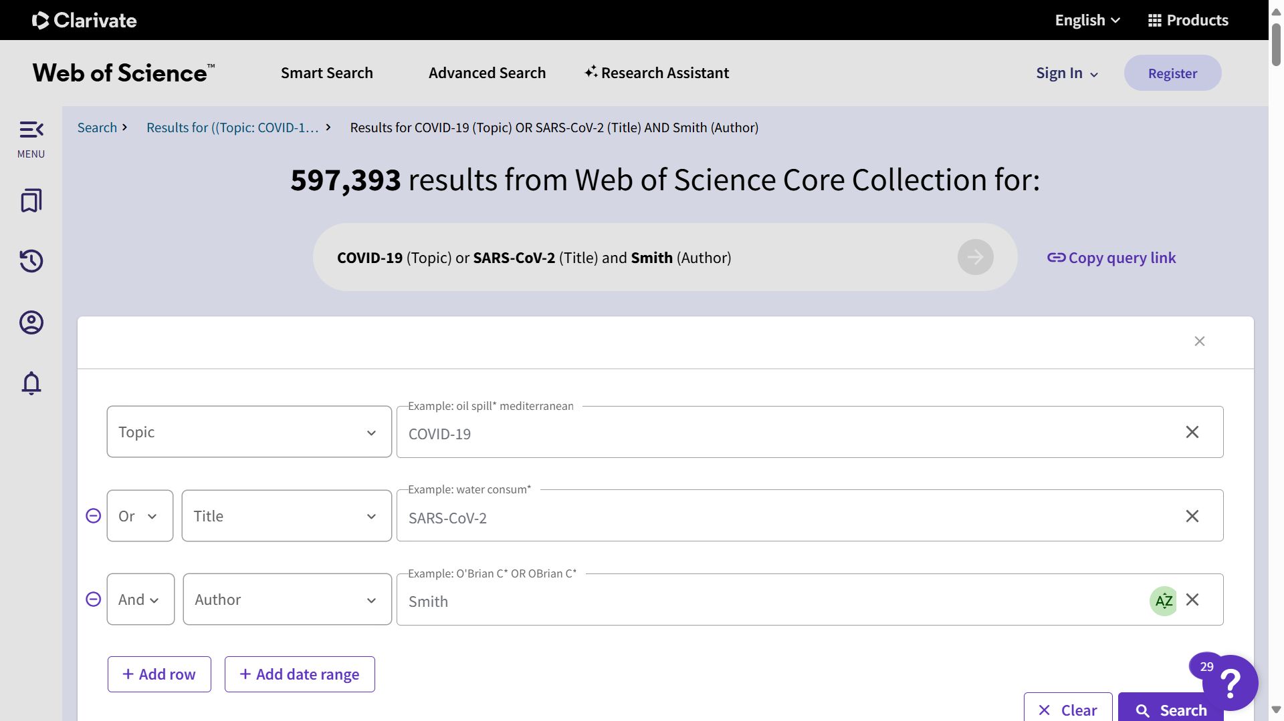
Advanced Search: An example
Example: ((Topic: COVID-19 OR Title: SARS-CoV-2) AND Author: Smith).
(i)
(ii)
(iii)
Notes:
Let’s look at a concrete example. Suppose we’re researching COVID-19 and want to find papers written by an author named Smith. We could type the following query into the Advanced Search box: This tells the system to find any records whose topic contains either “COVID-19” or “SARS-CoV-2,” and whose author field includes “Smith.” By practicing with a few examples like this, users quickly learn to build flexible and accurate search strategies.

Slide 15
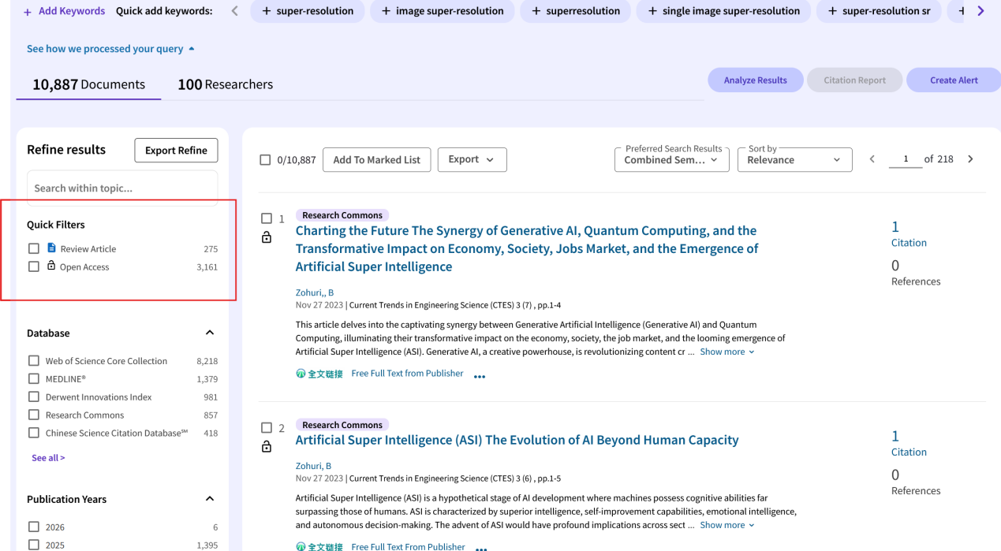
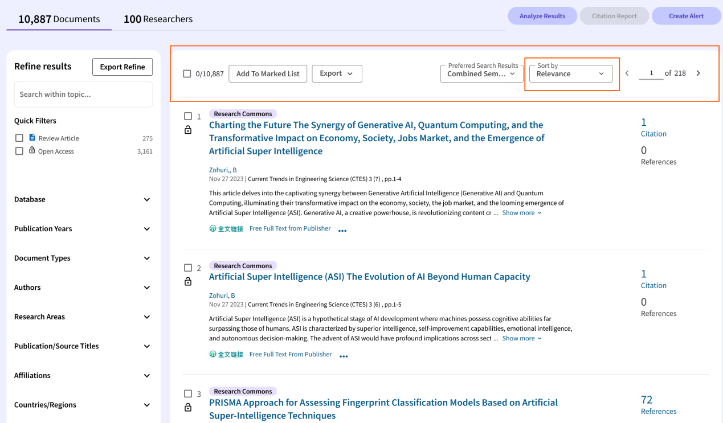
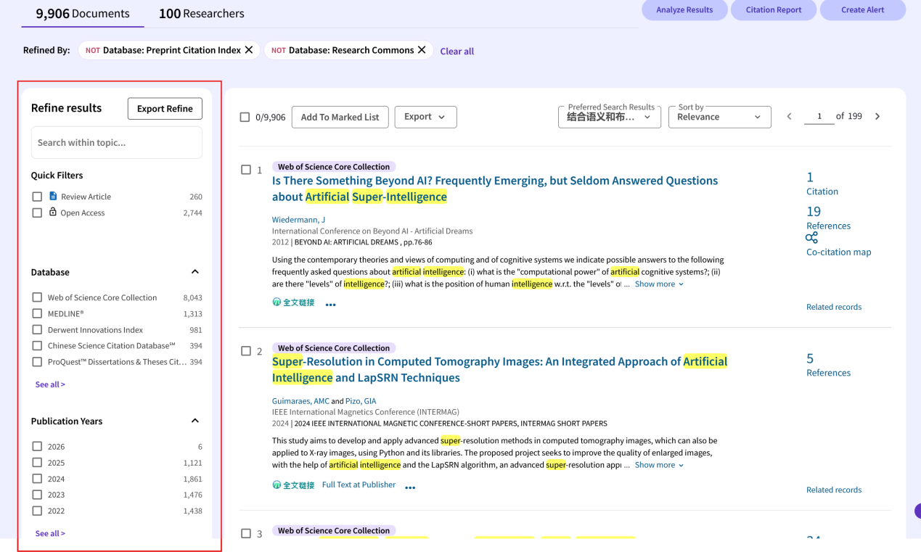
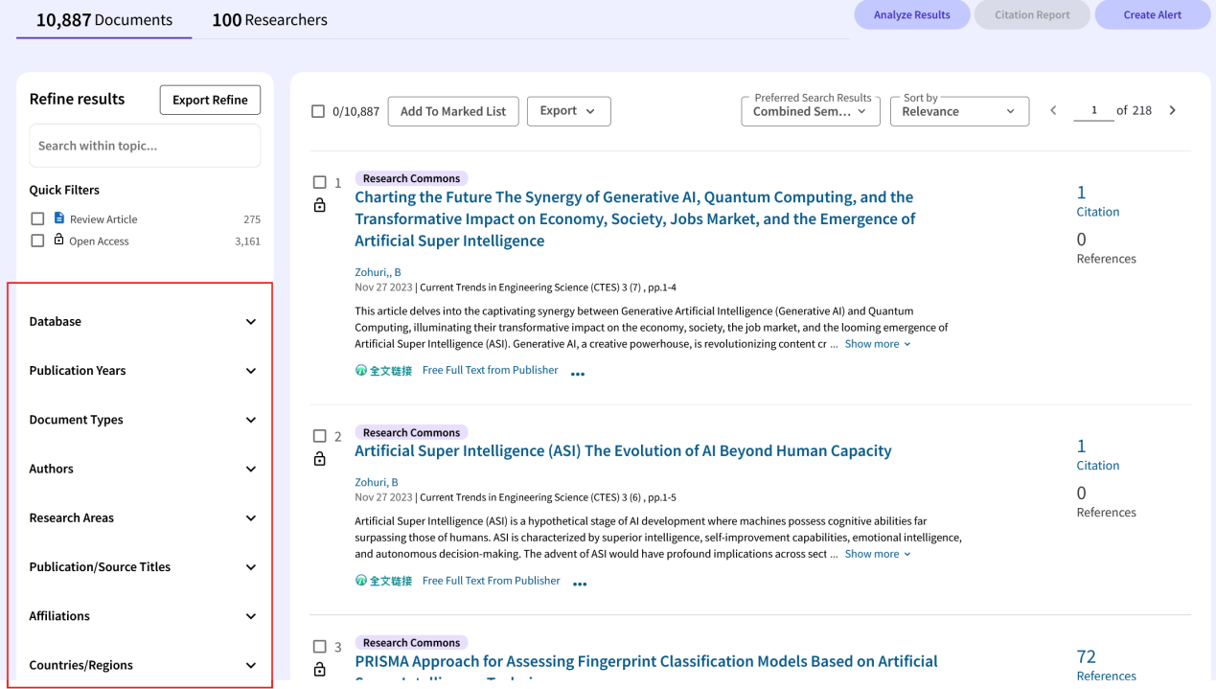
Filtering & Sorting
1. Locate the Filter Panel
3. Refine by Specific Attributes
2. Utilize Quick Filters
4. Sorting Results
Notes:
After running a search, never forget to narrow the results using the filter panel to meet your requirements. You can filter by year, document type, affiliation, etc. Use quick filters for common refinements and sort by relevance, date, or citation count. Our manual gives practical filter examples for typical research tasks.

Slide 16
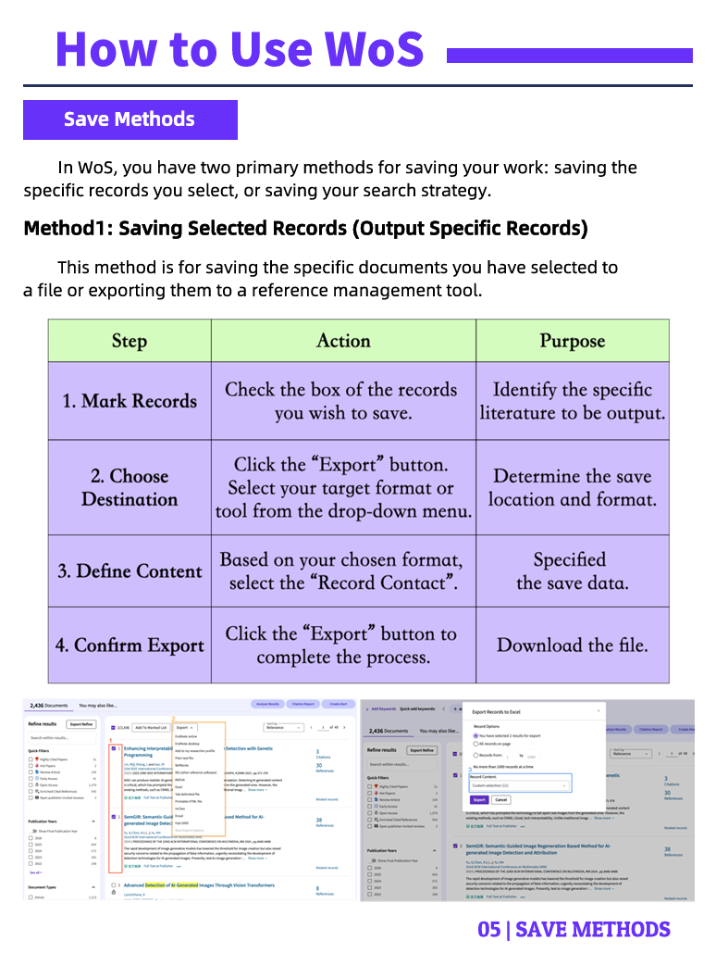
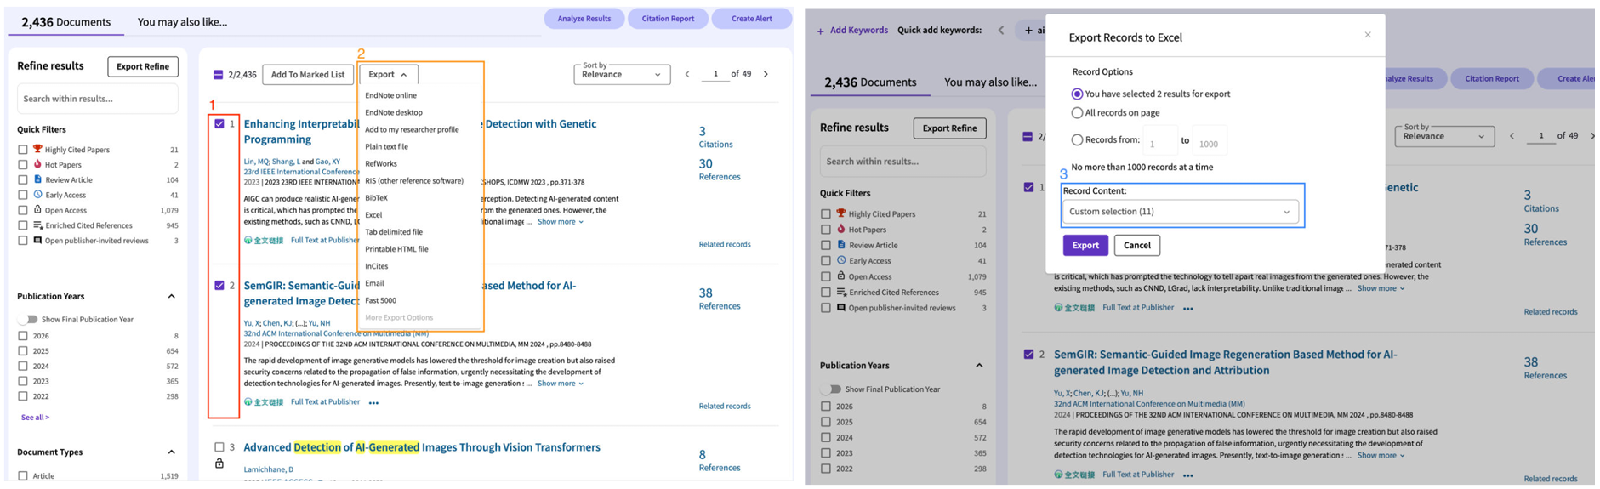
Saving Selected Records
WoS allows users to save selected records to a file or export them to a reference manager:
Mark Records.
Choose Destination.
Define Content.
Confirm Export.
Notes:
You can save specific records. To keep records, mark them, choose the export destination (file or reference manager), define which fields to include, and confirm. The manual includes screenshots for exporting to common formats and to tools like EndNote.

Slide 17
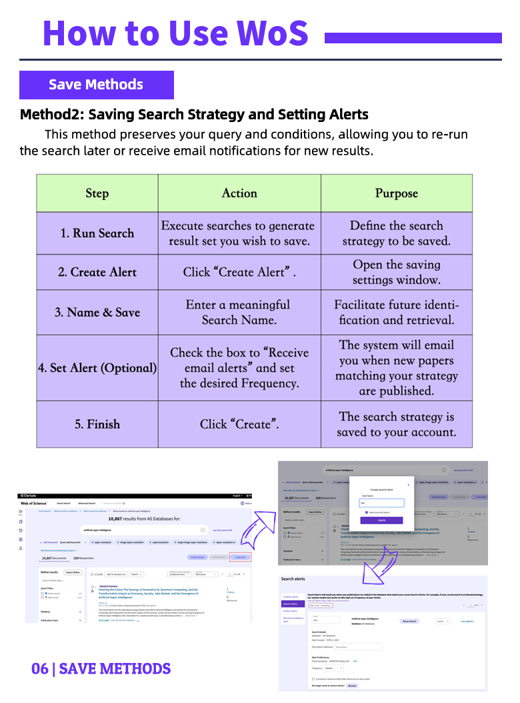
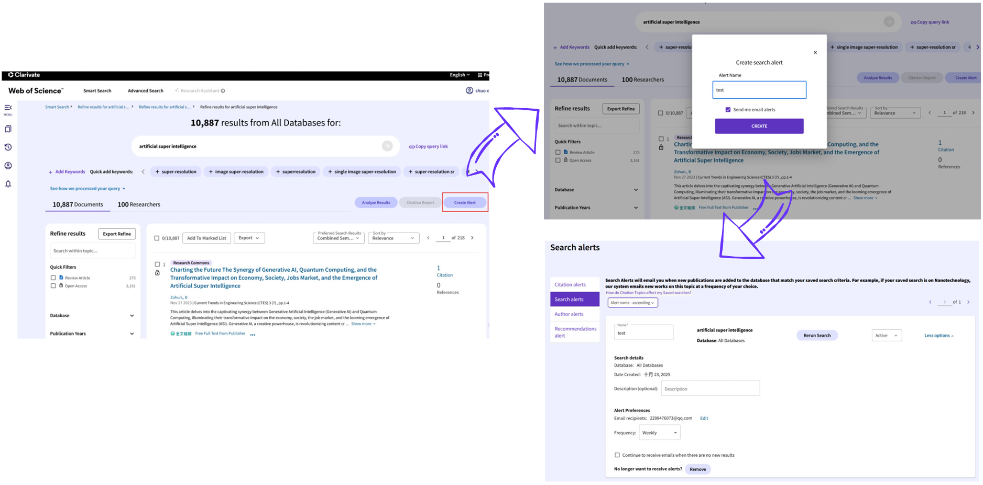
Saving Search Strategies
To re-run the search later or receive email alerts for new results, save the query and its conditions.
Click Create Alert after searching.
Name the search.
Check the box to receive email alerts and set the desired frequency.
Notes:
If you want to rerun searches or get notified about new items, save the query and create an alert. Name the search, set email frequency, and WoS will notify you when new matching records appear. This is handy for ongoing literature monitoring.

Slide 18
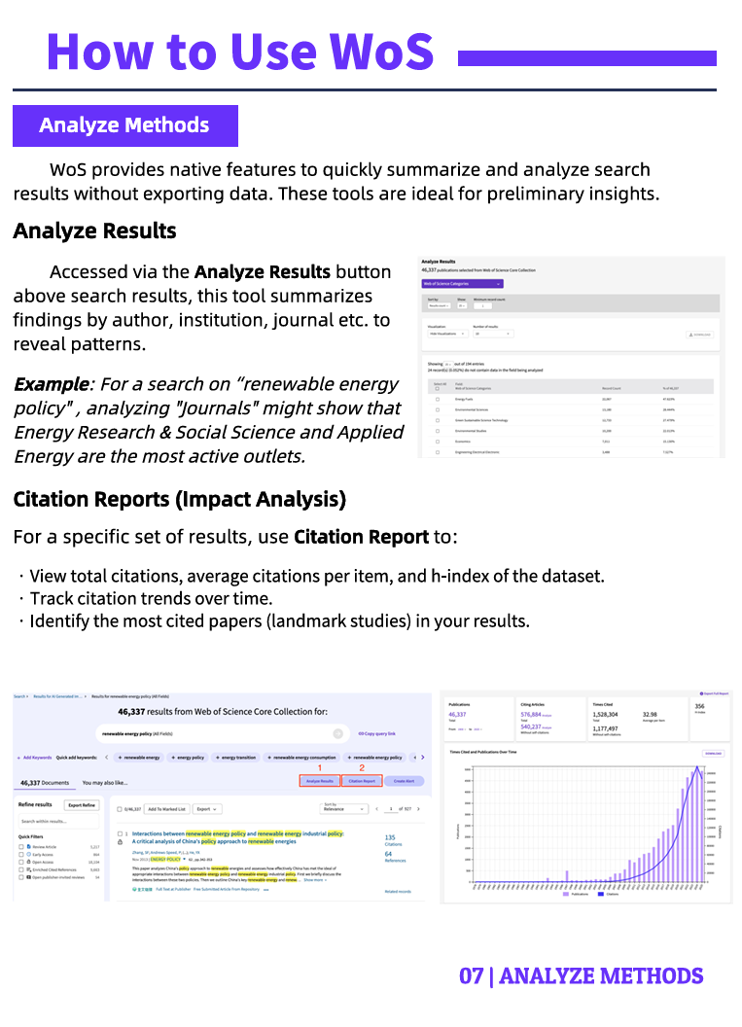
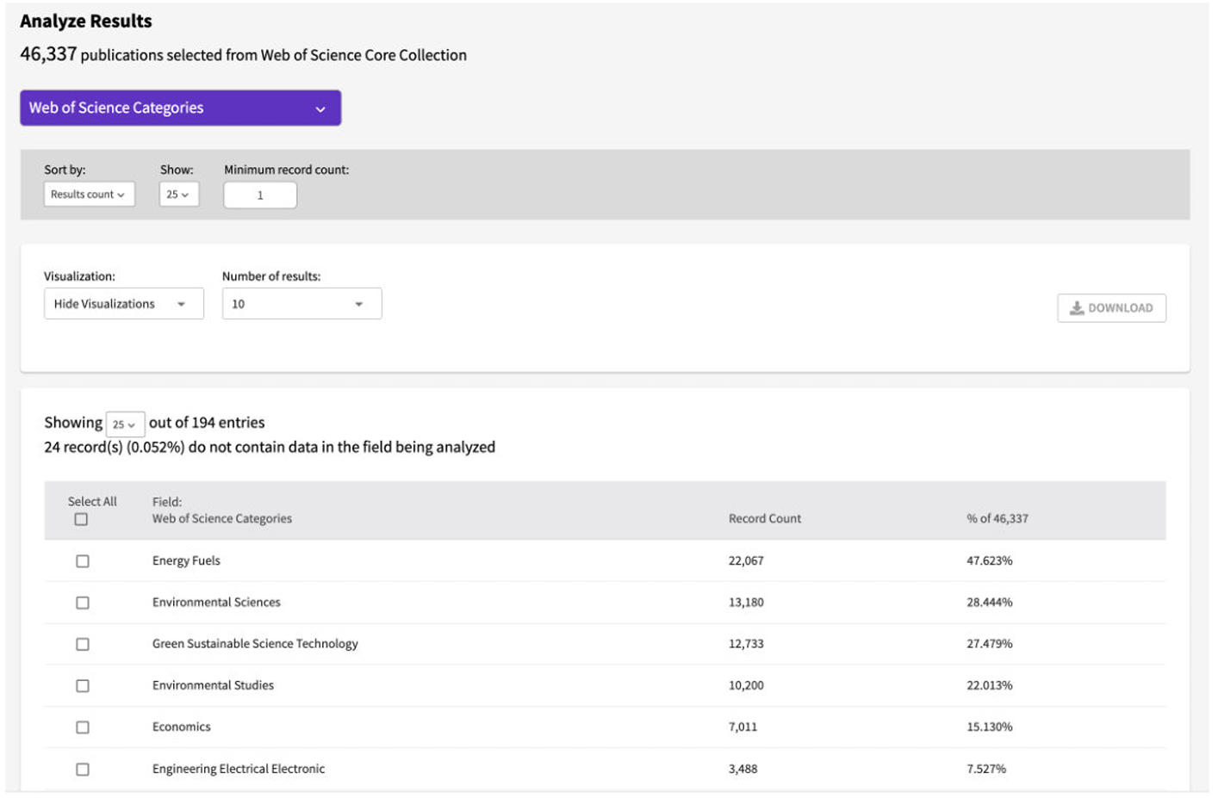
Built-in Analysis Tools
WoS provides native features to quickly summarize and analyze search results without exporting data. These features are ideal for preliminary insights and trend overviews.
Notes:
One of WoS’s strengths is built-in analysis. WoS has built-in analysis tools that summarize search results without exporting data. Hit “Analyze Results” to get quick breakdowns by author, institution, country, journal, and year. There are simple visualization options too — timelines of publication volume and basic co-authorship or keyword networks. These visuals are great for slides and for quickly identifying leading authors, hotspots, and trends in a field. And yes — you can export many of these charts for your reports.

Slide 19
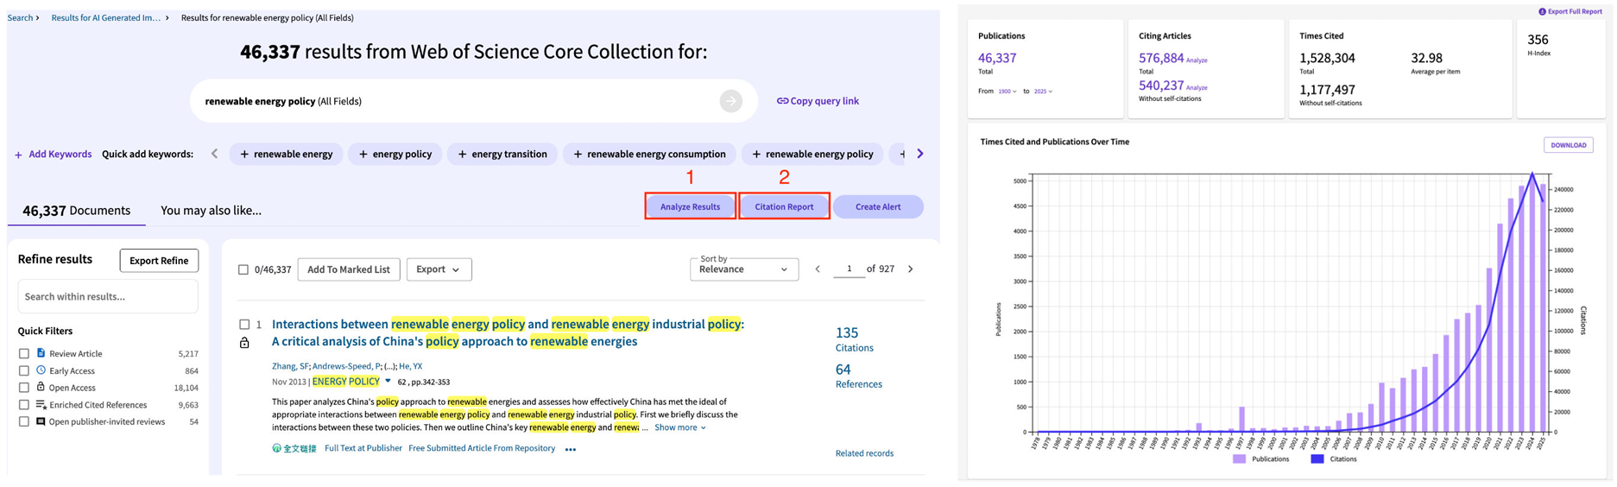
Citation Reports
Citation reports allow users to:
View total citations, average citations per items, and h-index of the dataset.
Track citation trends over time.
Identify the most cited papers.
Notes:
Don’t overlook the Cited Reference Search. This lets you find papers that cite a particular work. A citation report shows total citations, average citations per item, the h-index, and citation trends over time, and helps identify the most cited papers. It’s extremely useful when you want to see how a method or idea has been used or reviewed over time.

Slide 20
01 Introduction
02 Functional Workflow
03 Extension & Value
04 Work Allocation

Slide 21
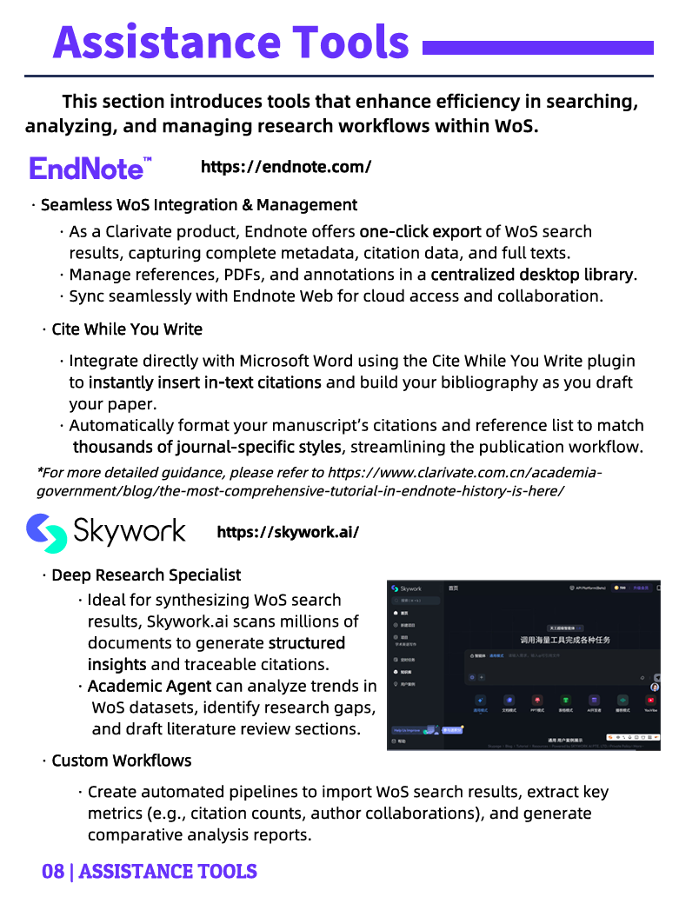
Assistance Tools
EndNote
WoS integrates with EndNote for seamless export and reference management, helping users organize citations and bibliographies efficiently.
Skywork
Skywork, the AI research assistant in WoS, summarizes results and suggests related literature to enhance research efficiency.
Notes:
beyond these core functions, WoS integrates with other tools that add practical value. WoS integrates with EndNote for seamless export and bibliography management. The manual shows step-by-step how to export references and generate citation lists, which saves time when preparing papers or bibliographies.
Skywork is WoS’s AI research assistant — it can summarize results and suggest related literature. The manual explains how to use Skywork as a starting point for discovery, and also highlights the need to verify suggestions by reading original papers.

Slide 22
Advantages
「
」
Streamlined user experience
Comprehensive citation ecosystem
Integration with AI-powered tools
Educational and research support value
「
」
Notes:
In short, this manual turns WoS’s powerful but complex features into clear, teachable steps. It streamlines the user experience, connects citation analysis with reference tools, and supports both teaching and independent research. Use it as your first stop when starting a literature review or preparing a class on database search.
To sum up, as more and more students need to find and organize papers efficiently, this manual helps make Web of Science easy to use. It walks you through common tasks step by step, offers quick analysis tools, and connects with EndNote and Skywork, which makes doing research a lot smoother and less stressful.

Slide 23
01 Introduction
02 Functional Workflow
03 Extension & Value
04 Work Allocation

Slide 24

Work Allocation
Runquan Zuo
Presentation
Xuanzheng Lin
Layout Designer
Wenzhuo Li
Content
Organizer
Shuo Xu
Content Organizer
Dawei Yan
Content Organizer
Zihao Han
Content Organizer

Slide 25
Thanks for your listening!

